Slide 1
CodeCademy Capstone Churn Project
Ben Guerrieri

Slide 2
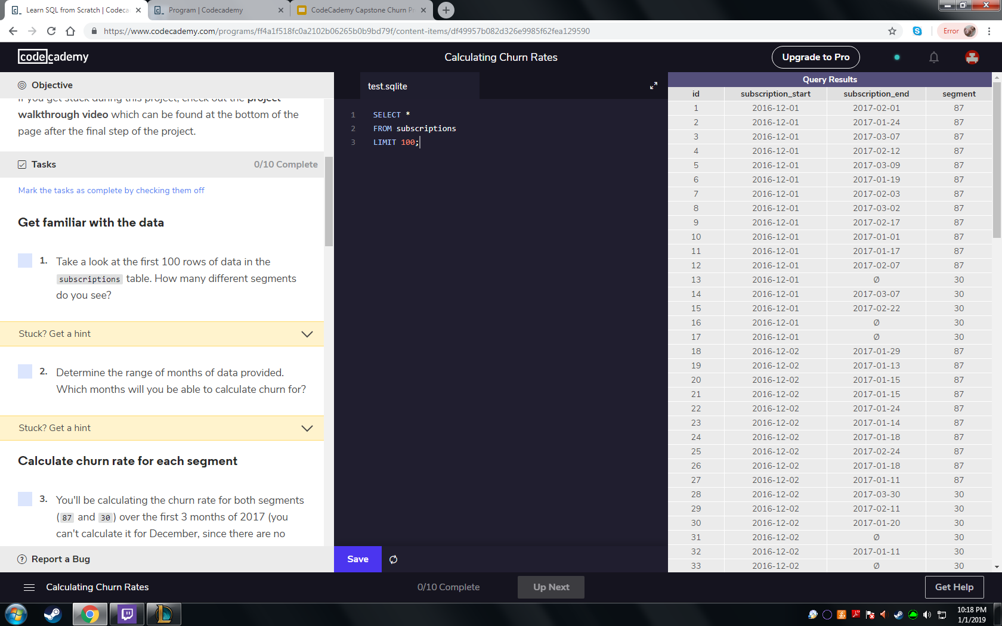
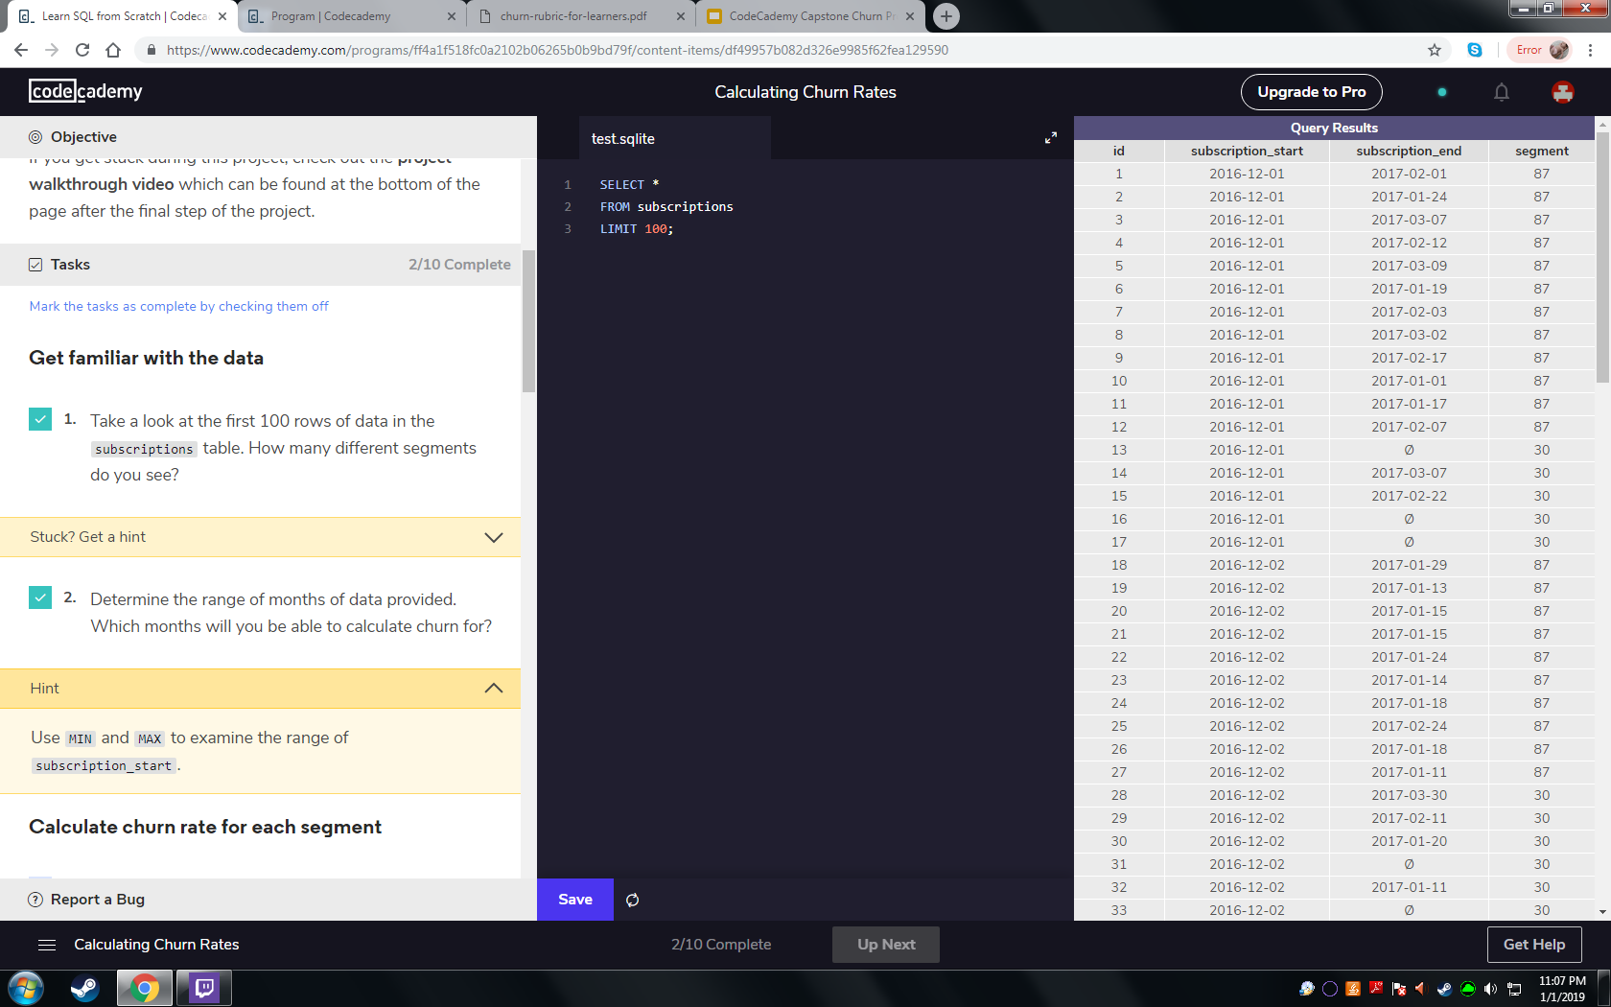
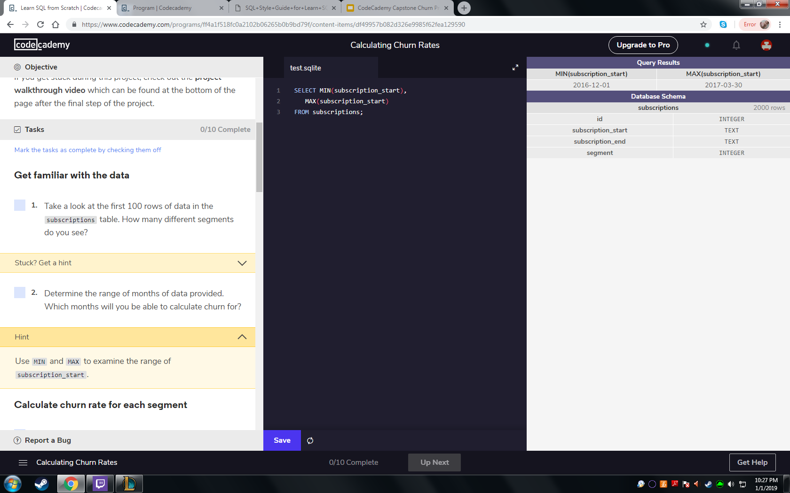
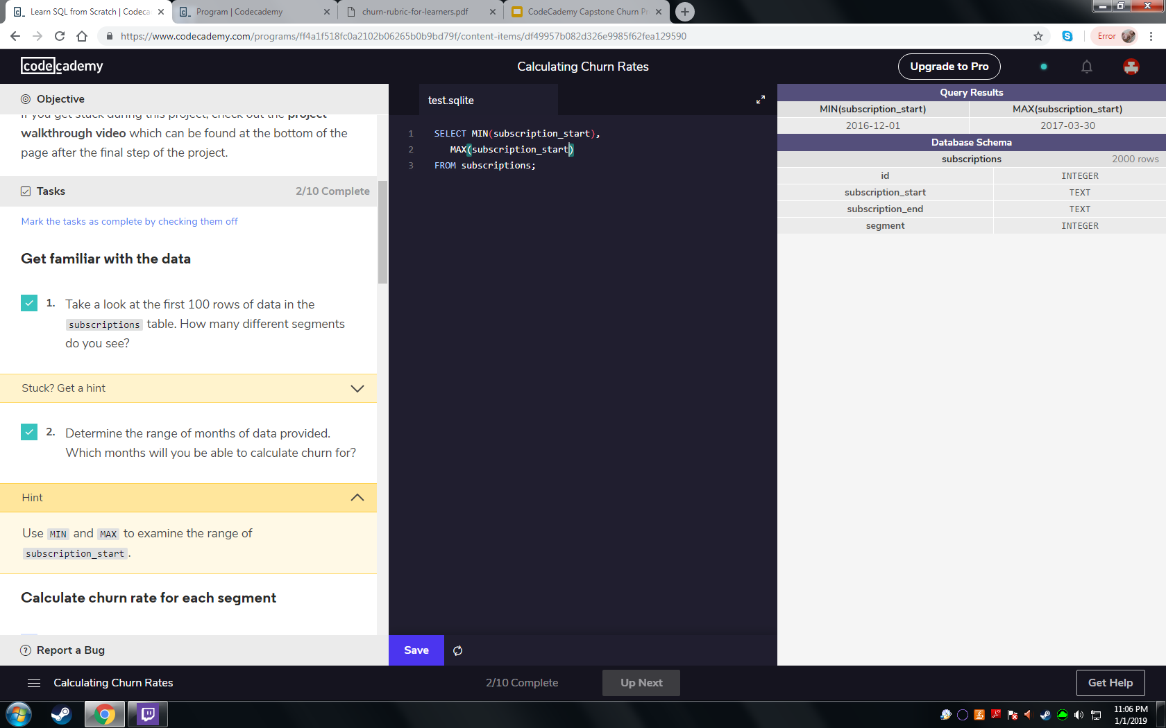
Getting Familiar
Q - How many segments do you see?
A - 2, Segments 30 and 87 using the following query:
Q - How many months has the company been operating?
A - The first subscription began on December 1, 2016 and the latest subscription began on March 30, 2017. Therefore the company has been operating for at lease a total of 4 months.

Slide 3
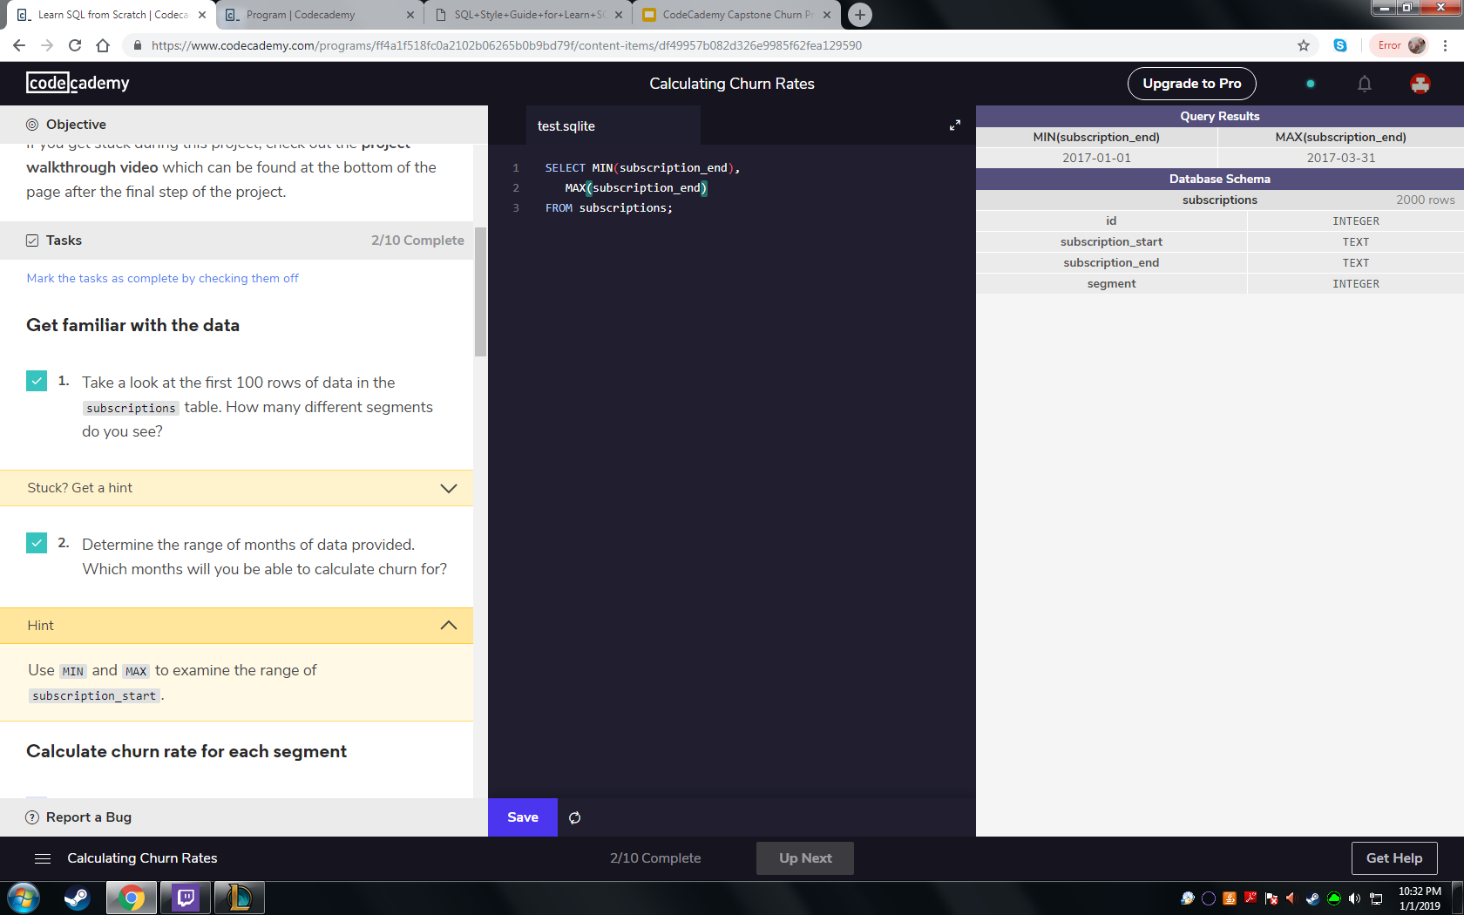

Getting Familiar Cont’d
Q - Which months do you have enough info to calculate a churn rate?
A - The only months that we have enough information to calculate churn are the first three months of 2017 as the earliest subscription end date is January 1, 2017 and the latest is March 31, 2017.

Slide 4
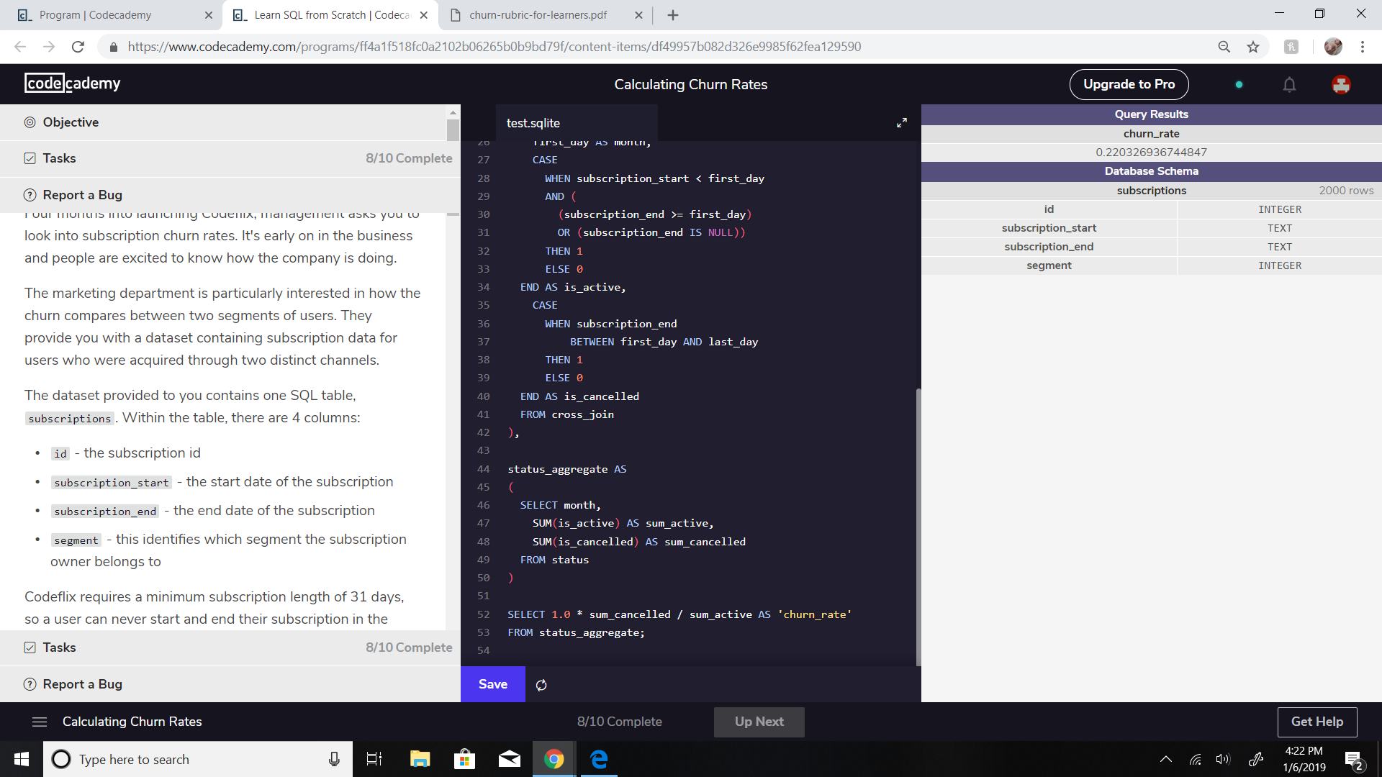
Overall Churn Rate
Q - What is the overall churn rate for the company over the first three months across all segments?
A - The overall churn rate from January 1, 2017 through March 31, 2017 is 22.03%.
To create a churn, I had to utilize multiple temporary tables to establish counts of subscriptions versus cancellations. These tables included:
A temporary table (months) to define the parameters for the months
A cross-joined table of “months” with the “subscription” table
A status table which adds the number 1 or 0 depending on whether or not the subscription beginning and ending date fits inside each individual month, and
An aggregate table which sums up the subscriptions and cancellations.

Slide 5
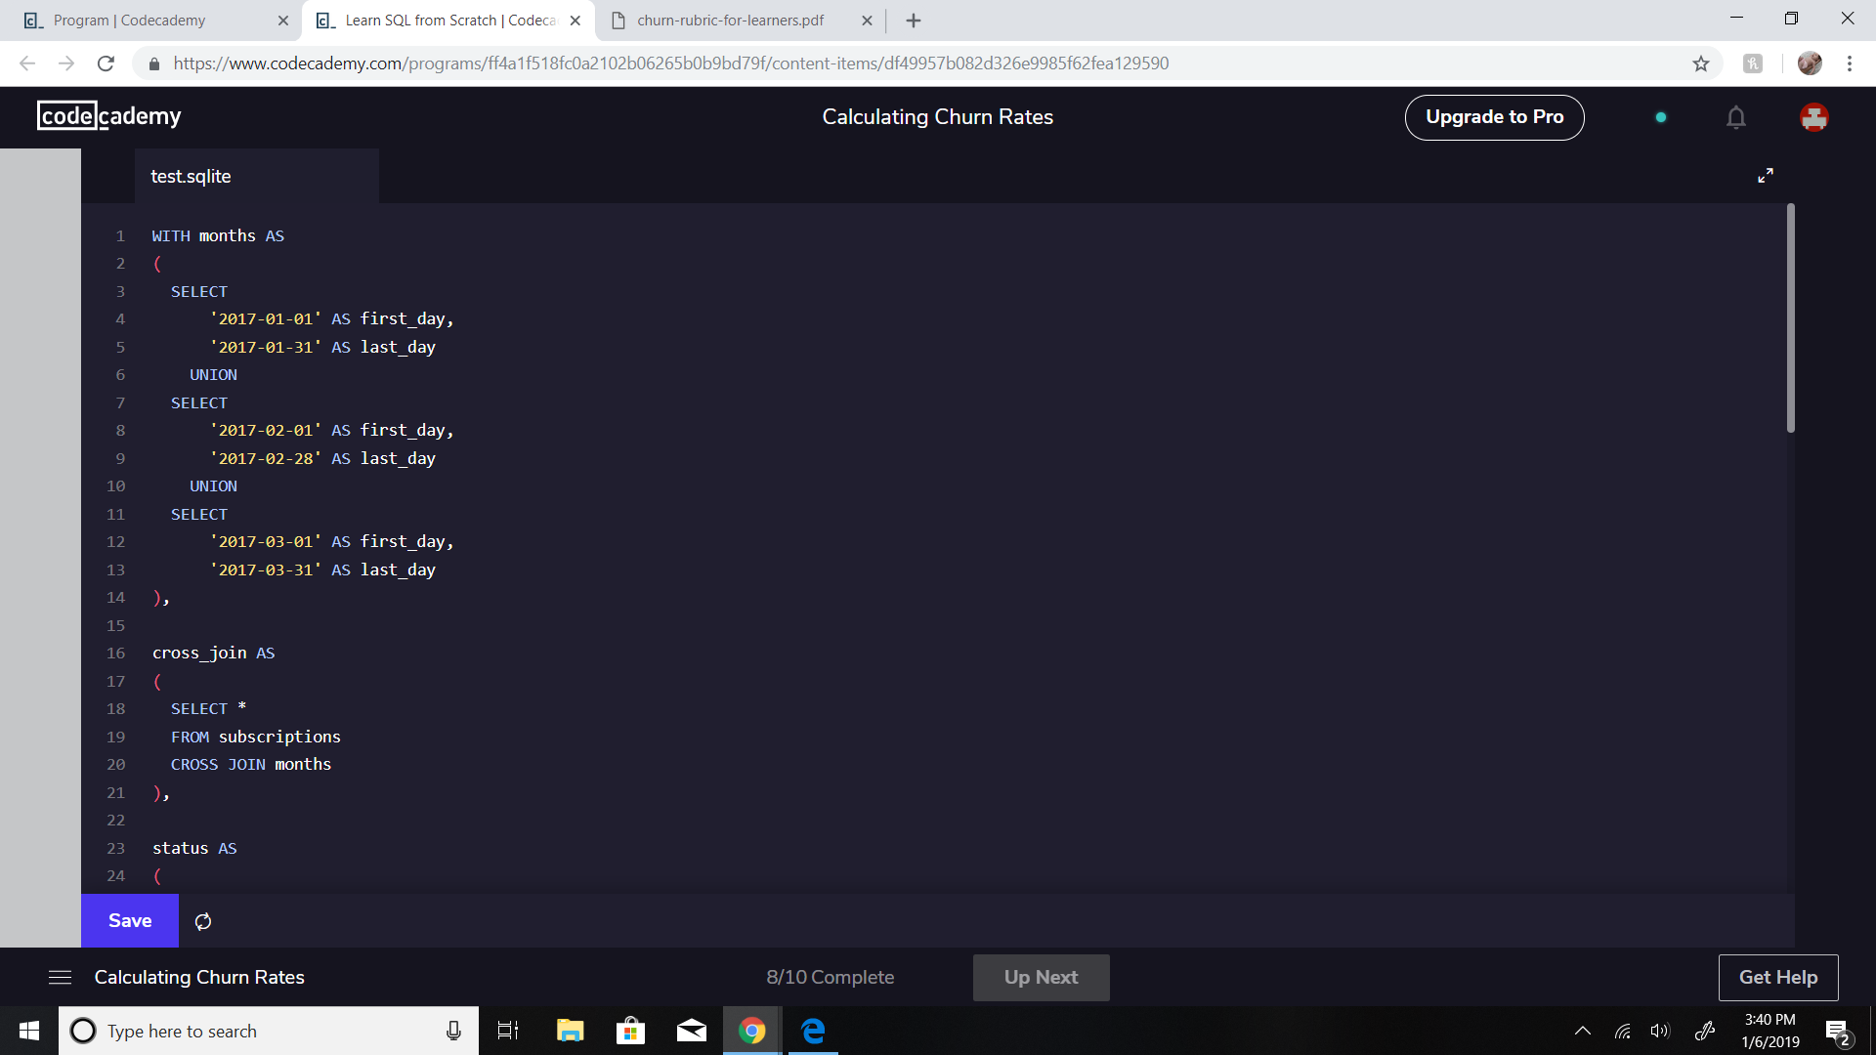
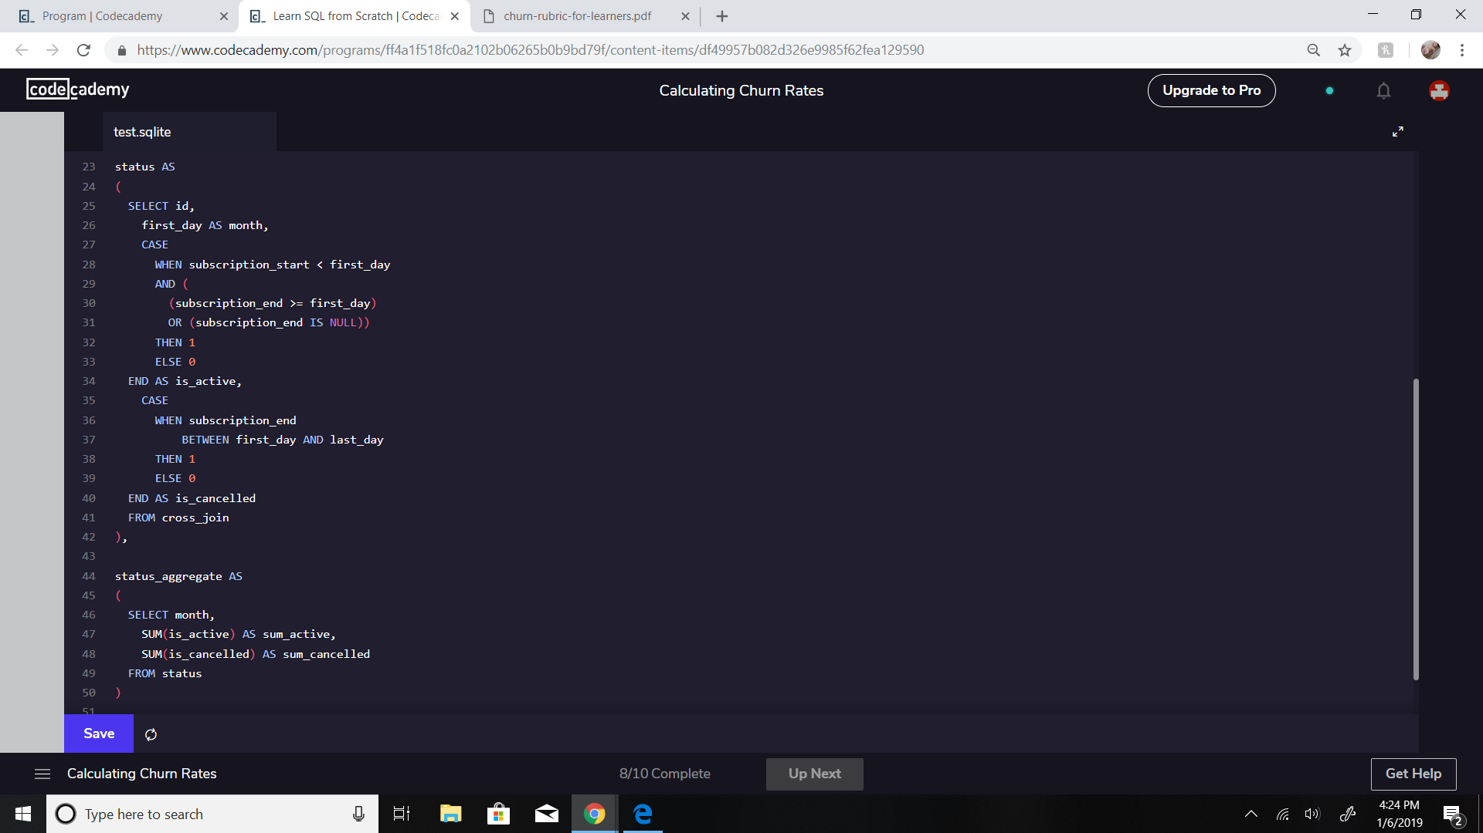
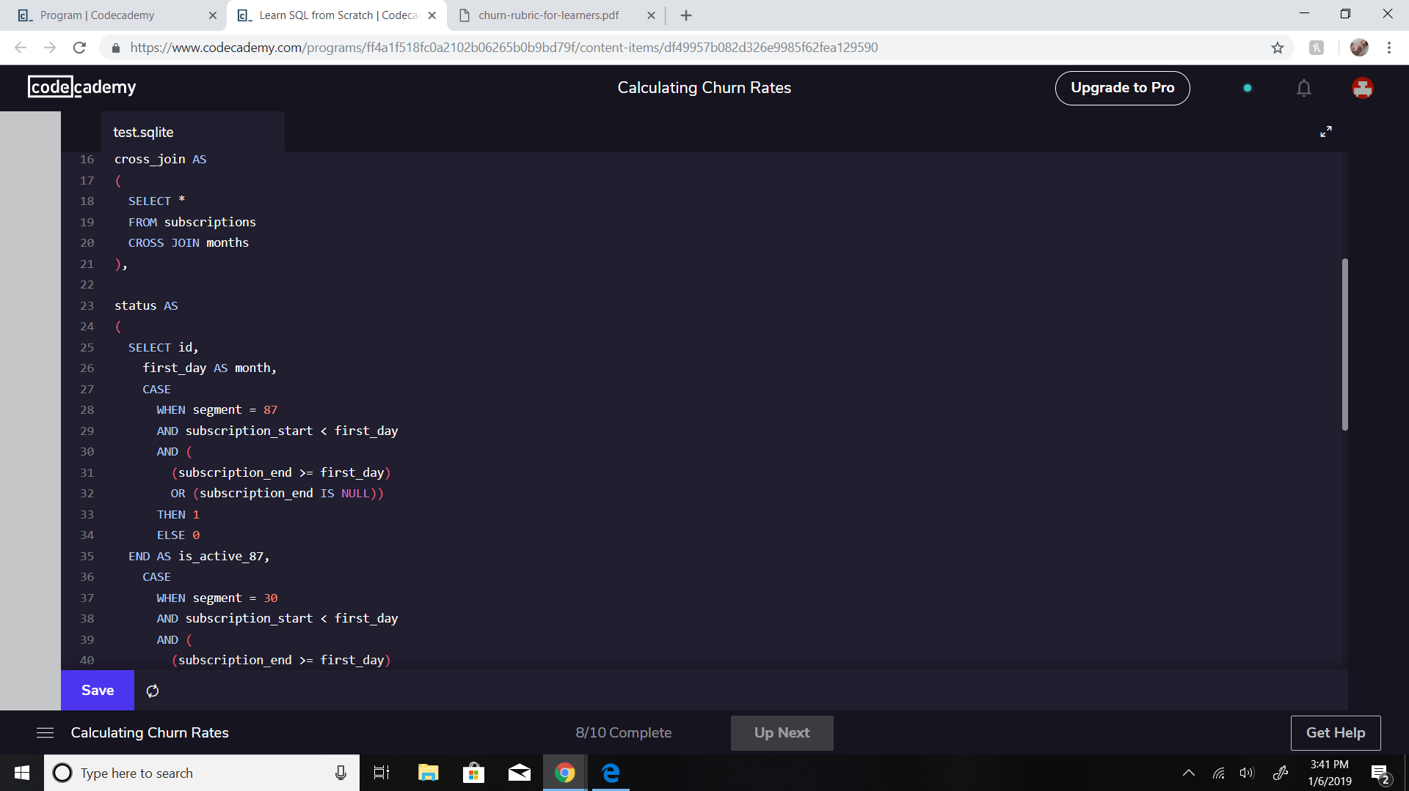
Overall Churn Rate Cont’d

Slide 6
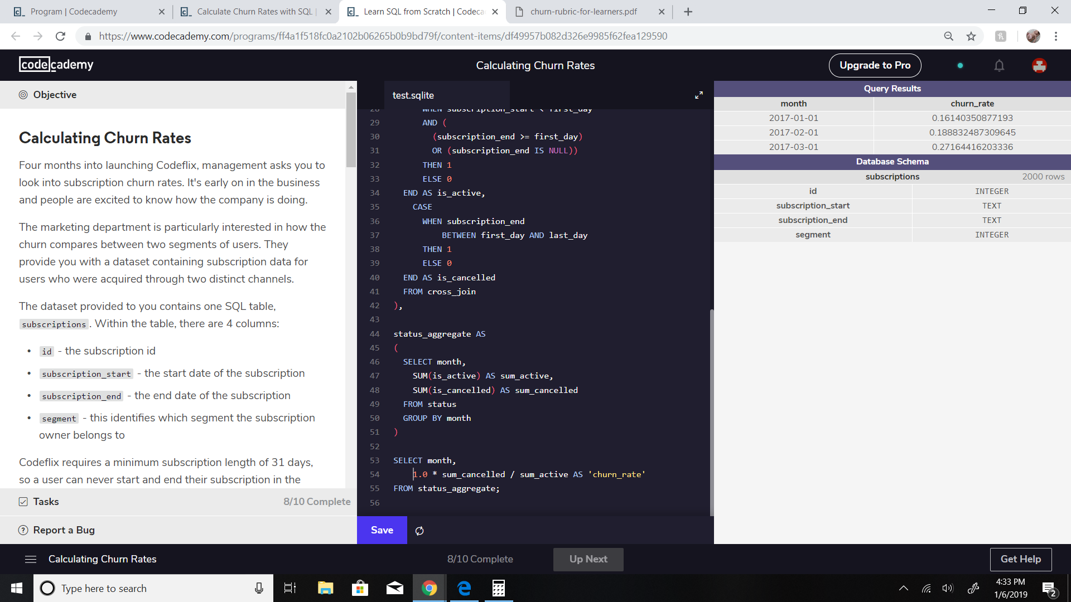

Overall Churn Trend
Q - What is the overall churn trend since the company started?
A - The overall churn trend by month is increasing by an average of 5.5% over the first three months. (January - 16.14%, February 18.88%, March 27.16%). This would mean that the number of cancellations is increasing faster than the rate of new subscriptions.
To get a rate by month, simply modify the overall churn trend by adding:
The months column to the status_aggregate temporary table
A group by function to the end of the status_aggregate temporary table, and
The months column to the final churn rate table to see all three months churn rates.

Slide 7
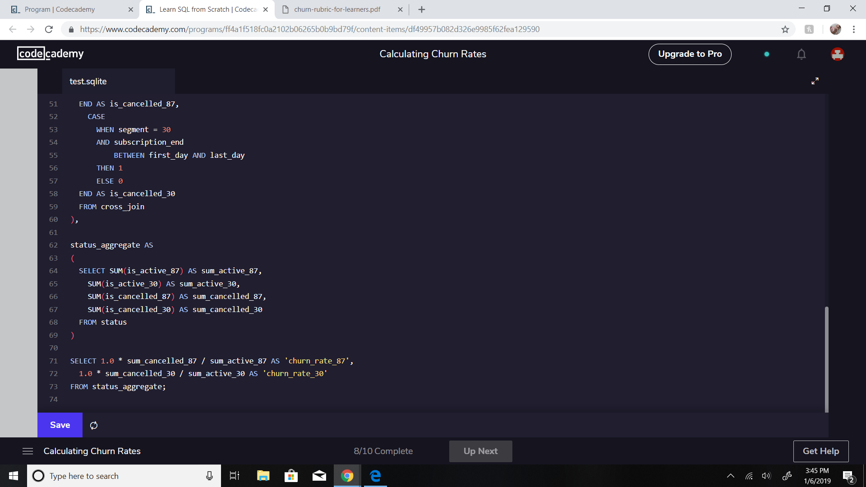
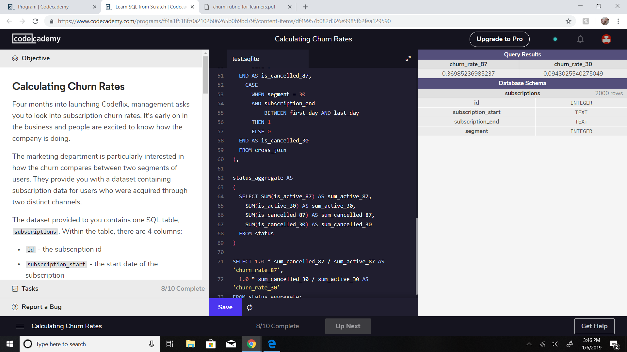
Segment Churn Rate Analysis
Q - What is the overall churn rate for each segment since the company started?
A - The churn rate is different for each segment of subscriptions. For segment 87 the church rate is 36.98% over the first 3 months of 2017. For segment 30 the church rate is 9.43% over the first 3 months of 2017.
To create individual segment churn rates, I had to utilize multiple temporary tables to establish criteria for each. These tables included:
A temporary table (months) to define the parameters for the months
A cross-joined table of “months” with the “subscription” table
A status table which adds the number 1 or 0 depending on whether or not the subscription beginning and ending date fits inside each individual month, and
An aggregate table which sums up the subscriptions and cancellations.
These aggregates allow me to complete the churn calculation. (see SQL code on next slide)

Slide 8
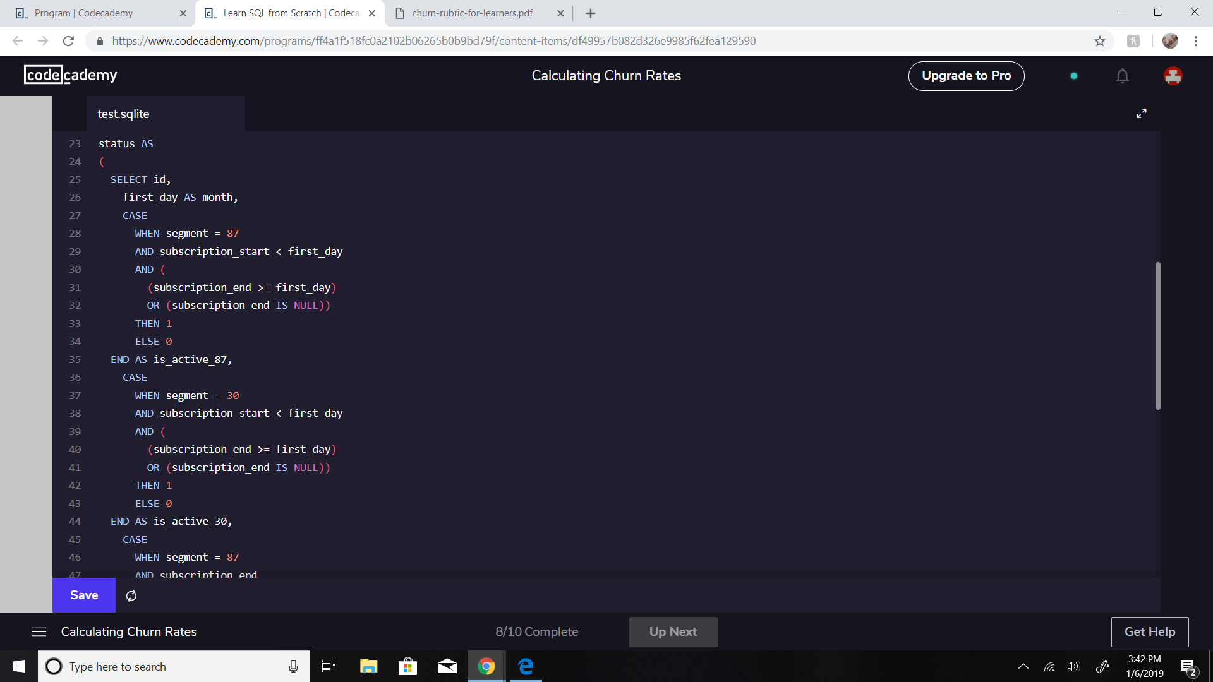
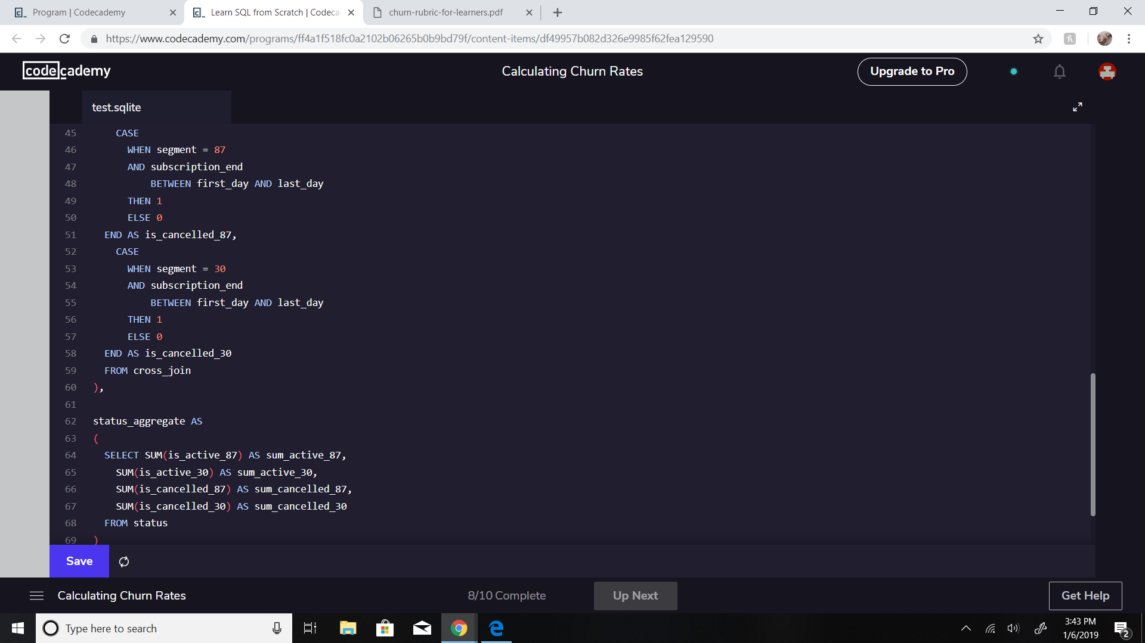

Segment Churn Rate Analysis Cont’d

Slide 9
Segment Churn Rate Analysis Cont’d
Q - Which user segment should they focus on expanding?
A - Based upon the total number of subscriptions for each (1000 subs per segment) and solely on individual churn rates, the segment they should focus on is segment 30 subscriptions. This segment of users has 27% less churn than segment 87.

